Slide 1
SMART SECURE HOME
ITI ADVANCED GRAD PROJ

Slide 2
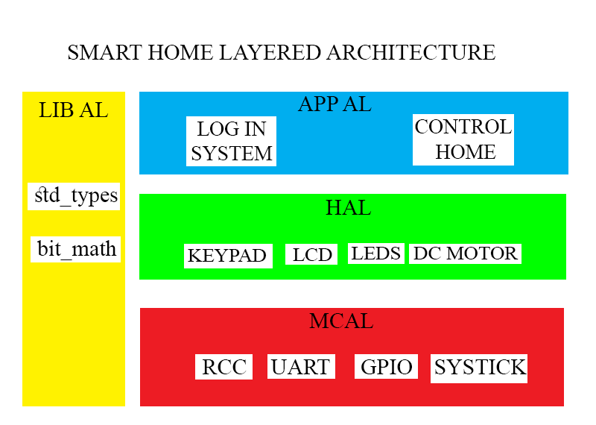
General Idea
Smart home with a log in system able to control different parts of the house using 2 stm32f401cc.
The project is done using layered architecture and simulated on Proteus.

Slide 3
Application
The Application code is split on 3 parts that will be discussed in detail.
The first MCU has 2 application codes the first is used as a log in system to make the house secure and the second to send commands via UART to the second MCU which is responsible with controlling house hardware.
The Log in System:
a 4 numbers password system that gives the user 3 trails to enter the password and if he enters it correctly the controlling system options are displayed on LCD.
The password is given in a prebuild configuration in login_system.h .

Slide 4
Controlling System
First MCU
After successfully login to system.
The options to control home are displayed on LCD up to 9 options that can be given by keypad.
Option ‘0’ is used to turn the page.
For each command the application sends to the second mcu to take appropriate action via uart.
Second MCU
Has the third application code which receives command using uart from first mcu and control the desired part of the house.

